Slide 1
Homer data

Slide 2
CO / OBS interleaved
Session 0
CO
OBS

Slide 3
CO / OBS interleaved
Session 1
CO
OBS

Slide 4
(Gromit for ref):
Session0
Session 6

Slide 5
(Jeev for ref):
Session2

Slide 6
Which commands are used (box=command, color=#movements)
MAG
Uses drift to go this way
ANG

Slide 7
Movements / used command
Homer

Slide 8
Mean diffs; TODO: figure out scaling to appropriate axes for z-scored spks

Slide 9
Pairwise correlations b/w diffs for a command and way the command is used
Frac sig. commands
G
J
H

Slide 10
Dynamics on z-scored H data
Explain better than shuffling and conditioning, but R2 are terrible
Want to try on non-zscored data

Slide 11
Example # commands / move, min_obs = 0

Slide 12
Example # commands / move, min_obs = 15

Slide 13
# movements per command

Slide 14
Mean diffs, w/ zscoring, nshuffs=20
Frac. Difference from mean
Z-score
Z-score
Perhaps issue w/
scale by N for small N

Slide 15
Mean diffs, NO zscoring, nshuffs=20
Frac. Difference from mean
Perhaps issue w/
scale by N for small N

Slide 16
WITH z-scoring and WITH conditioning
WITHOUT z-scoring WITH conditioning
Homer
Homer

Slide 17
Plot pred. activity
Plot pred. command
WITH z-scoring and no conditioning
WITHOUT z-scoring and no conditioning

Slide 18
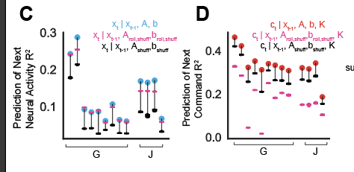
With z-scoring NO conditioning
Plot activity
Plot action

Slide 19
WithOUT z-scoring NO conditioning
Plot activity
Plot action

Slide 20
Dynamics – w zscoring (same as without)

